Slide 1

Role of cloud in iT management
Presentation By:
Goutami Padmanabhan
Balaji GurumoorthY

Slide 2
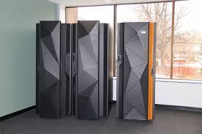
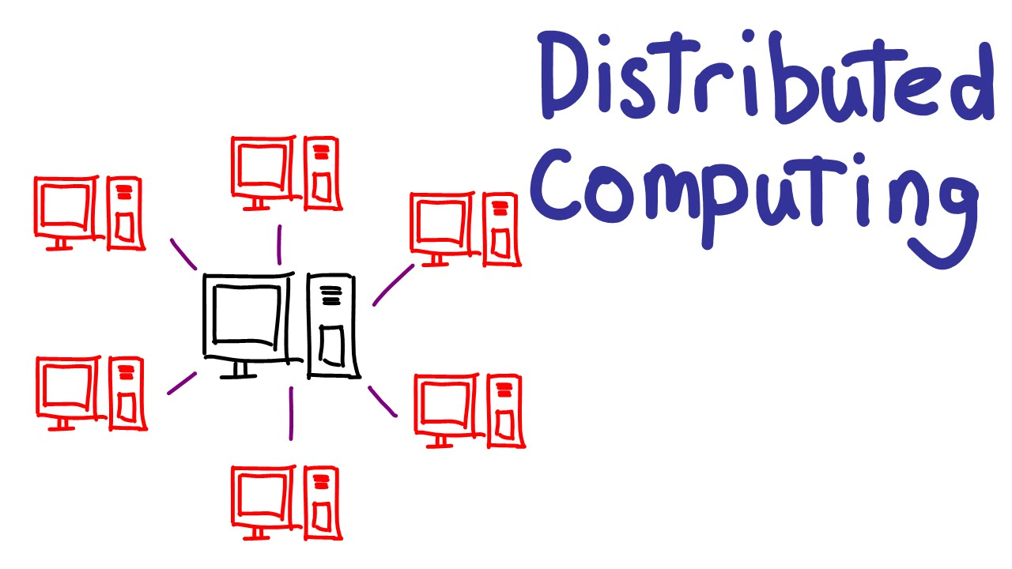



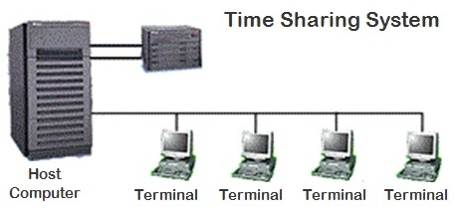
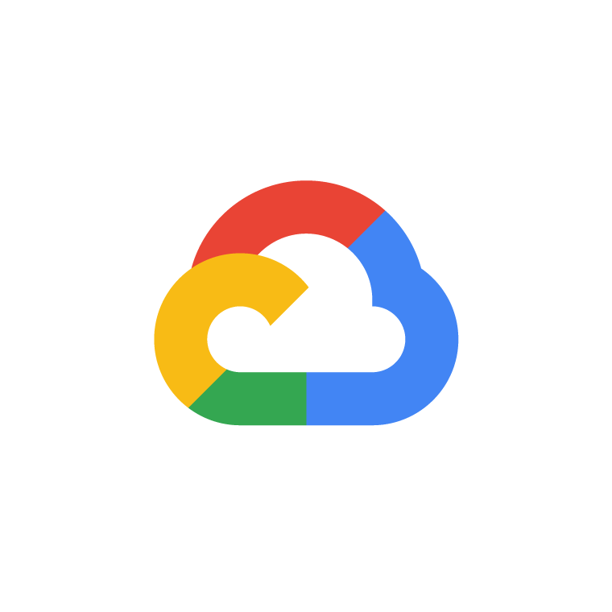
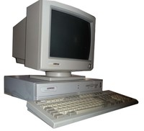
Timeline
Mainframe Computers
Term “Cloud” Introduced
Amazon and IBM
Microsoft Azure
1950
1950
2010
1950
1950
1950
1950
1950
1950
1950
1950
1950
1950
1950
1960
1960
1960
1960
1960
1960
1960
1993
1993
1993
1993
1996
2006
1996
2008
Time Sharing Services - IBM
Cloud Computing
Google Cloud

Slide 3


Before Cloud
Problems
For hosting a website, we need to
Buy a stack of servers
Keep the peak traffic in mind and buy more servers
Monitoring and Maintenance of your own servers.
Infrastructure Setup Expensive
Troubleshooting Problems
Traffic is Varying – Peak/Idle
Want of SME’s was More
IT Management of Various Teams was Difficult

Slide 4

What is Cloud?
In Layman Terms
Remote servers on the Internet
On-Demand Computing Services
Why Cloud?
Alternate to Own Infrastructure and Data Centers
Rent and Pay by Use
Avoid Up Front Cost and Complexity

Slide 5
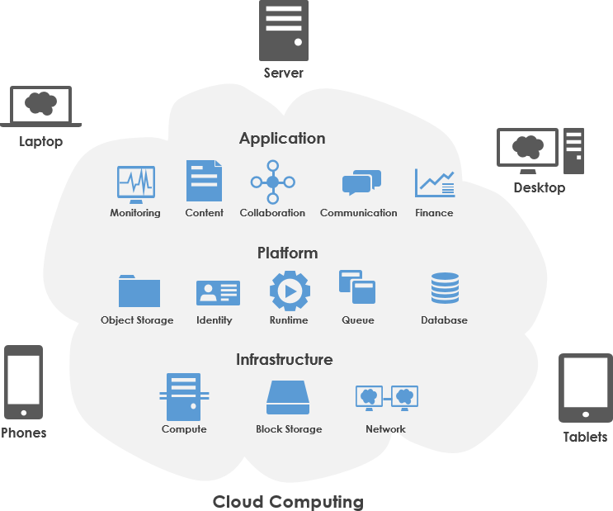
Cloud Computing
SaaS
PaaS
IaaS

Slide 6
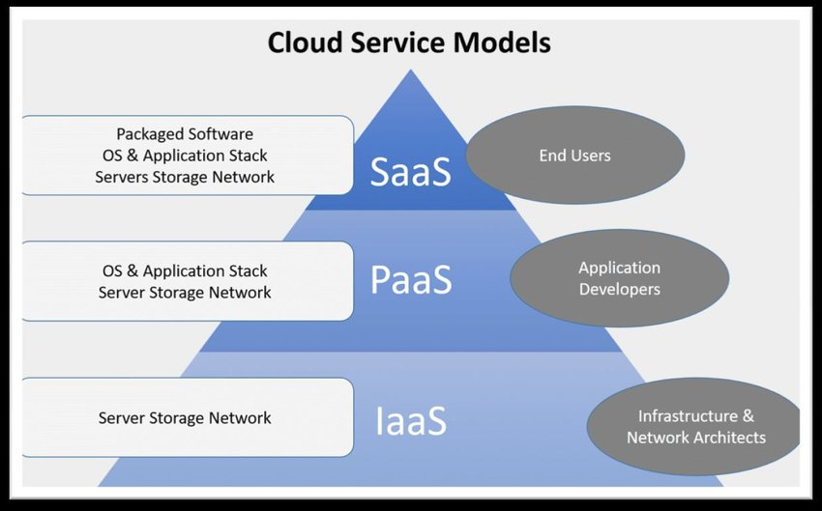
Cloud Service Models

Slide 7
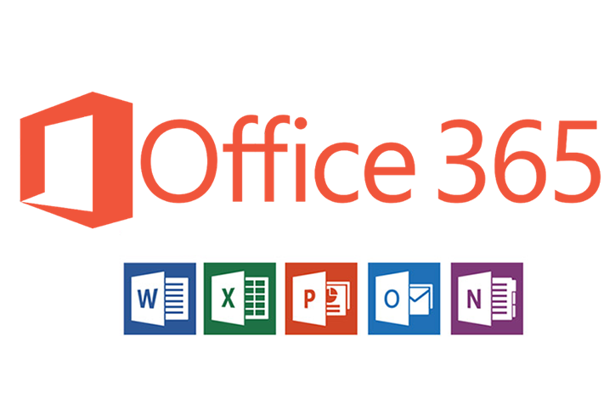





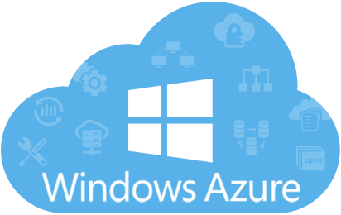


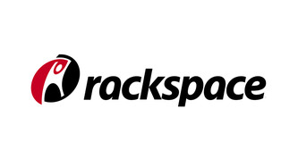
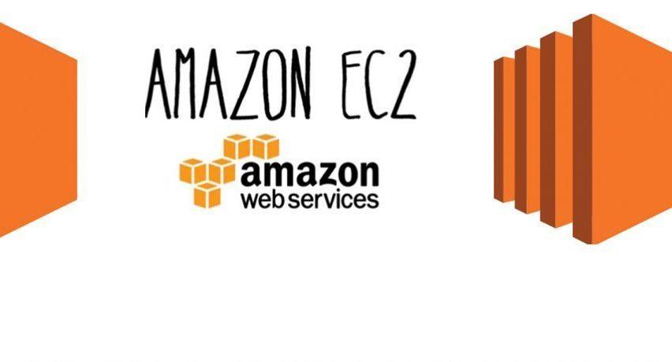
Cloud Service Models – It’s Applications
SaaS
PaaS
IaaS

Slide 8
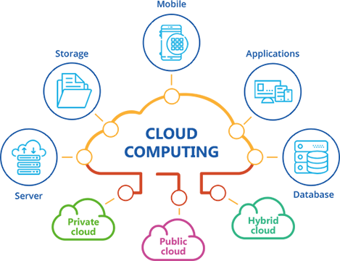



Efficiency
High Availability
Reliability
High Performance
Role of cloud
I t management

Slide 9
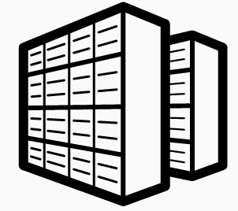


IT Management – Infrastructure (Data Center Vs Cloud Vs Hybrid)
On Premises
Cloud
Hybrid

Slide 10
Cloud in IT Management – Responsibilities and Tasks
Budget & Costs
Business
Require
ments
Data Protection
Safety & Compliance
Cloud in IT Management
Network Security
Imple
mentation
Tech Support
Storage Management

Slide 11

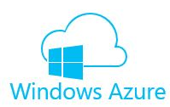
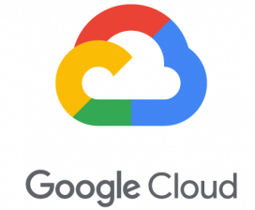
Current Cloud Market and Their Role in IT Management
No 1 in Market Position
No 2 in Market Position
No 3 in Market Position - 3%
42%
+ Market Position
+ Global/Scalability
-Too many features
- Cost Structure
30%
+ Hybrid Cloud
+ Open Source Support
- Documentation Issues
- Less Enterprise Focussed
+Big Data /ML
- No Global Reach
- Not Enterprise Focussed

Slide 12
Future Role of Cloud in IT Management
Hybrid IT Solution
DaaS
More Software Centric
Simplified Operations
Avoids lock into a single provider
Data Integrity
Encryption – Security
Network Segmentation
Manage & Deploying workstations
3rd Party Cloud Provider Manages everything

Slide 13


Recent Stats
Migration
Clouds Market Share
20% of Applications will be moved to Cloud in Next Few Years
$246.8 billion to $383 billion by 2020
Azure’s Success
$10 Billion – US Defense Contract – Public Cloud Infrastructure
AWS Market Share
Projected Market share of 52% among all
IT Spending
Digital Infrastructure
IT spending on Cloud will grow by 6 times
Managing - Driverless Cars, Drone Taxis, Smart Power Grids etc.,

Slide 14
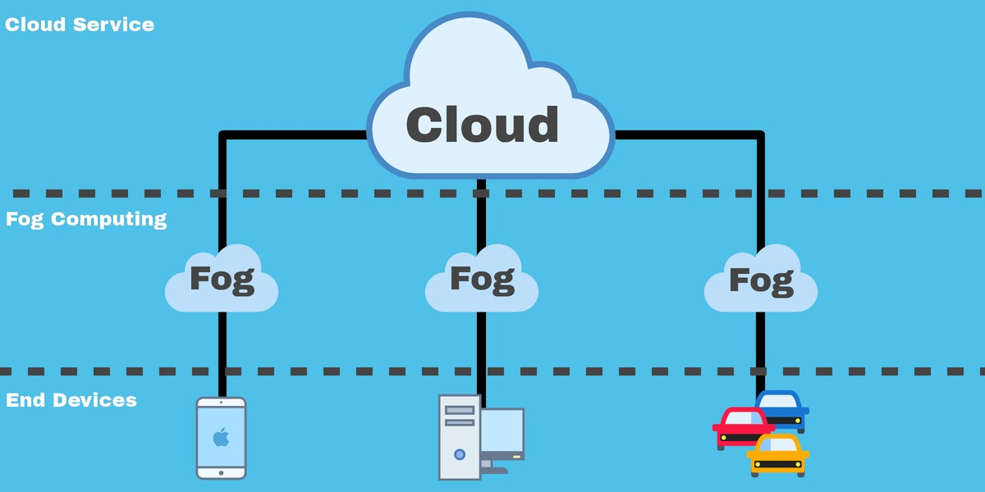
Our Opinion
Fog Computing
Edge Computing
Defines Edge
Computing
End Devices & Cloud
Distributed N/w
Processing of data close to edge devices
Sensors at edges
Not sent to remote cloud
Advantages/Application
Advantages/Application
Saves Network Bandwidth
Low Operational Cost
Connected Cars
Smart Cities
Removes Processing Latency
Ideal for IoT

Slide 15
Summary
Concept of Distributed Computing evolved in 1960
Introduction to Cloud – Enables ubiquitous, convenient, on-demand network access to a shared pool of resources with minimal management effort.
SaaS, PaaS, IaaS
Application of Cloud in IT Management
Current Trends
Our Opinion
Role of Cloud In IT Management

Slide 16
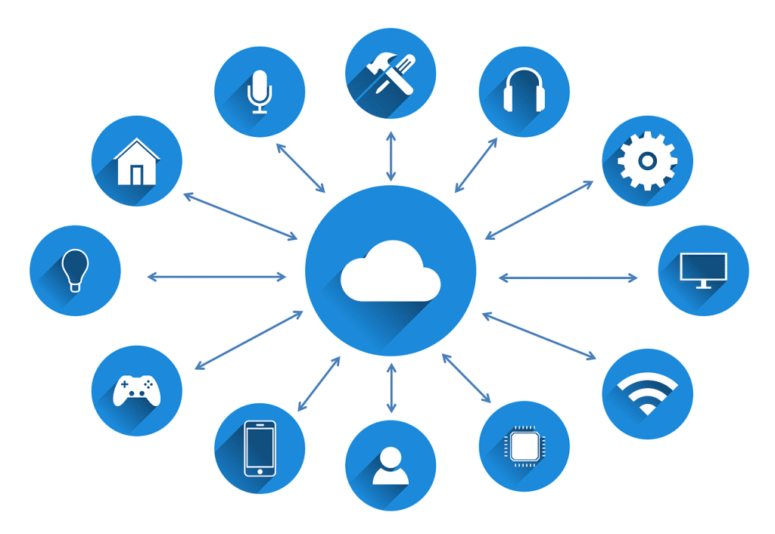
References
https://www.youtube.com/watch?v=IT1X42D1KeA
https://www.uniprint.net/en/7-types-cloud-computing-structures/
https://www.technologyreview.com/s/425970/who-coined-cloud-computing/
https://www.ecpi.edu/blog/a-brief-history-of-cloud-computing
https://en.wikipedia.org/wiki/Cloud_computing#Early_history
https://www.forbes.com/sites/johnwebster/2019/10/17/it-management-in-the-cloud--how-much-is-really-getting-done-for-you/#172598946736
https://www.ibm.com/topics/it-management
https://www.ibm.com/cloud/learn/iaas-paas-saas
https://aws.amazon.com/what-is-cloud-computing/

Slide 17
Thank You

